Slide 1
Simutech : python in chemical engineering

Slide 2
Acknowledgement
I would like to thank our chemineers society for providing this project and also I would like to thank Mr. Samanvay for their efficient mentorship and for teaching this project and for clearing our doubts and queries to our satisfaction, regarding the process and progress of this project.

Slide 3
assignments
Stokes’s law
Heat diffusion equation
Simulating flow and temperature profile in heated tube
Simulating flow and temperature profile through a double pipe heat exchanger

Slide 4
Stokes’s law
Mathematical equation that expresses the drag force resisting the fall of small spherical particles through a fluid medium

Slide 5
The drag force Fd acting upward in resistance to the fall is equal to 6πrηv, in which r is the radius of the sphere, η is the viscosity of the liquid, and v is the velocity of fall.
The buoyancy force Fg acting downward is equal to ⁴/₃πr³ (d₁ − d₂)g, in which d₁ is the density of the sphere, d₂ is the density of the liquid, and g is the acceleration due to gravity.
Terminal velocity is the maximum velocity (speed) attainable by an object as it falls through a fluid.
Terminal velocity (vt )= ²/₉(d₁ − d₂)gr²/η.

Slide 6
derivation

Slide 7
Heat diffusion equation

Slide 8
derivation

Slide 9
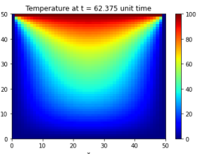
Final Temperature profile

Slide 10
Simulating flow and temperature profile in heated tube

Slide 11
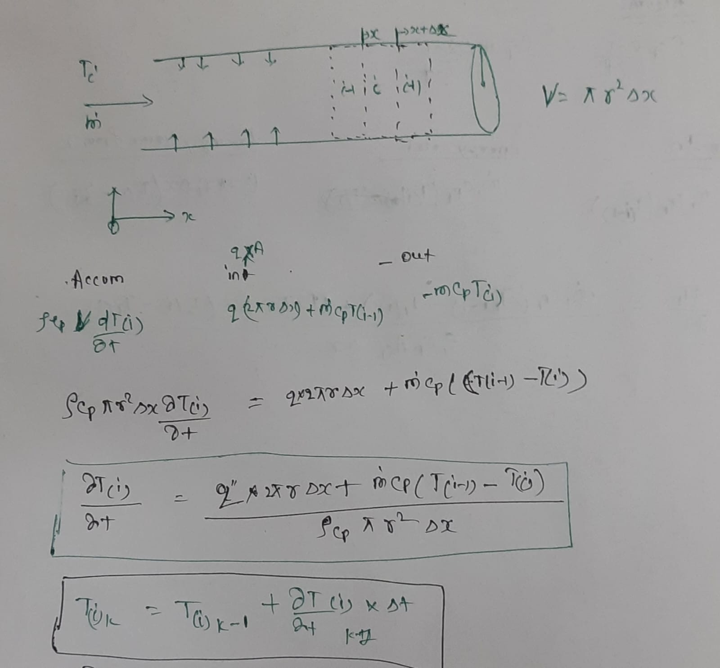
derivation

Slide 12
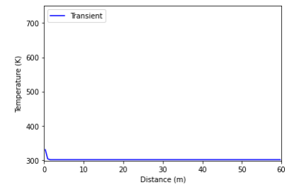
Temperature profile
At t=0

Slide 13
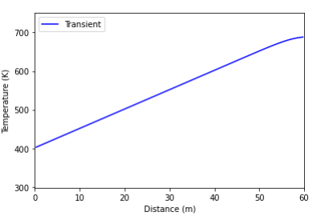
Final Temperature profile

Slide 14
Simulating flow and temperature profile through a double pipe heat exchanger

Slide 15
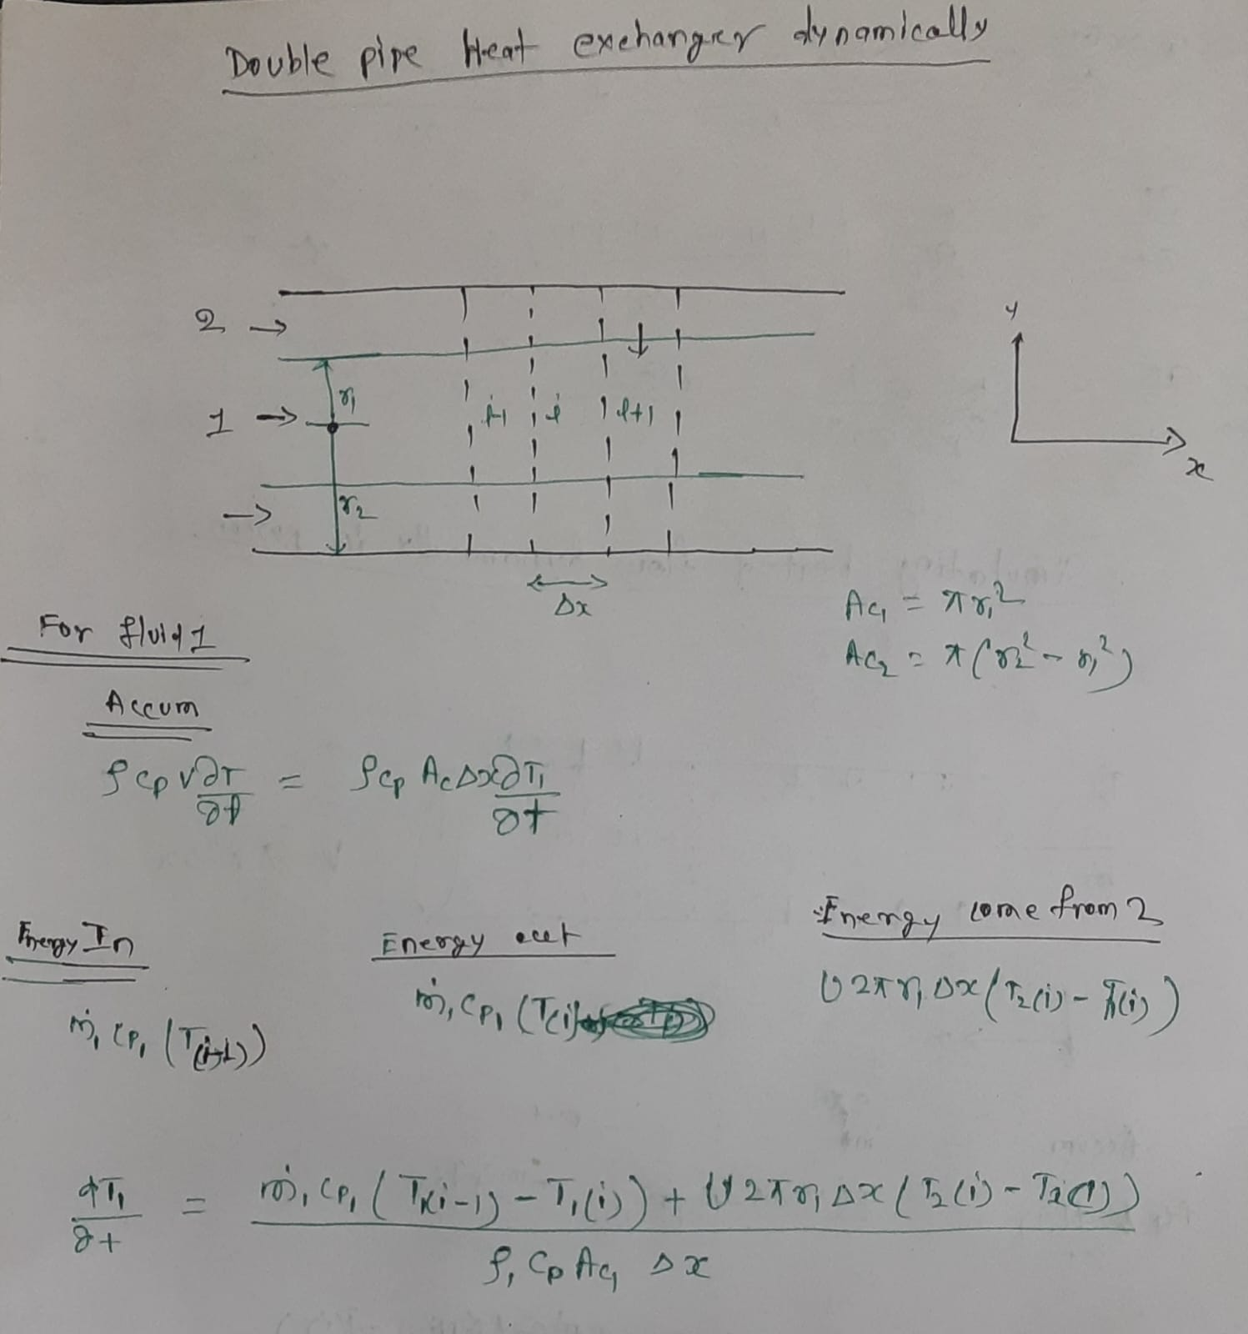
derivation

Slide 16
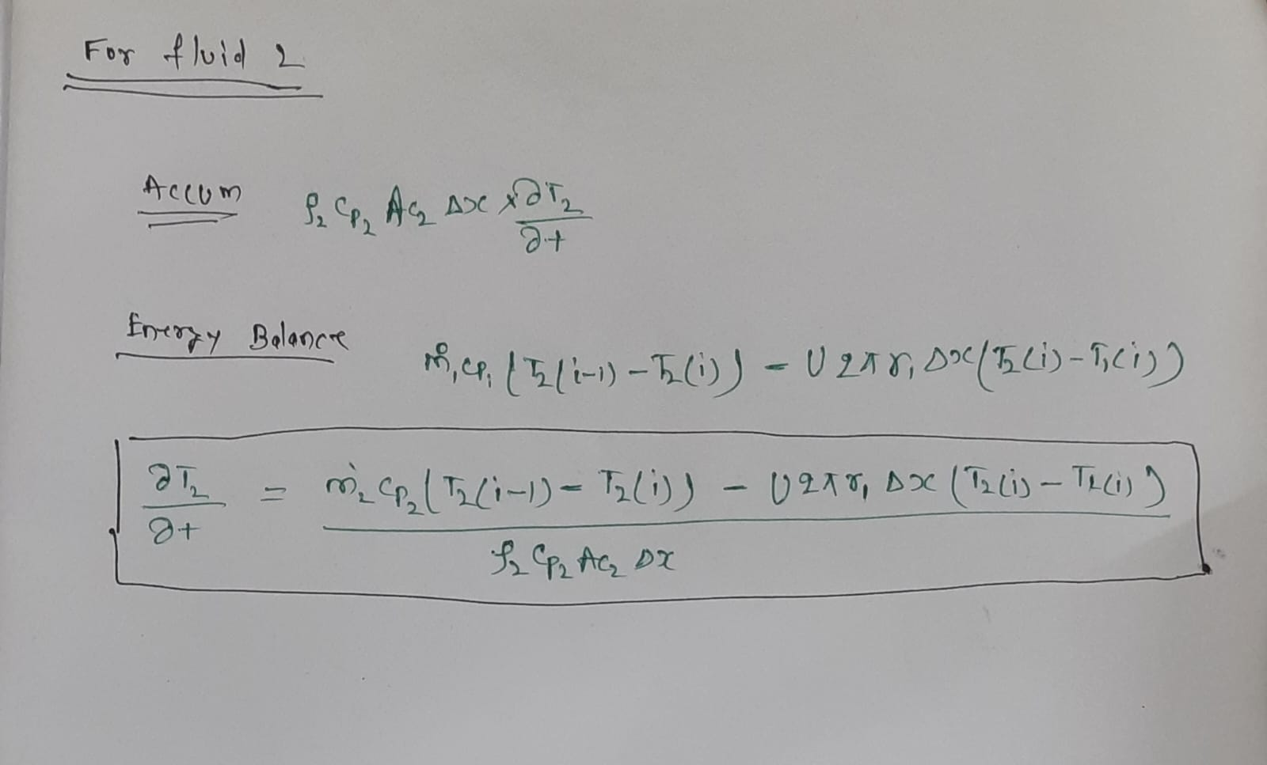

Slide 17
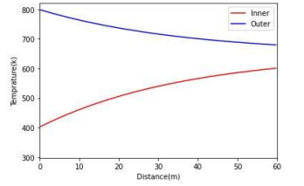
Temperature profile of inner and outer pipe

Slide 18
Thank You

